Slide 1

Energy Demand Forecasting
Capstone 2 Project: Springboard Data Science Career Track

Slide 2
Project Problem and Stakeholders
Accurate energy forecasts are critical for maximizing use of renewable sources and minimizing reliance on fossil fuels.
Accurate forecasts are important to system operators for planning and maximizing grid stability.
Allow renewable generators to correctly price their energy.

Slide 3
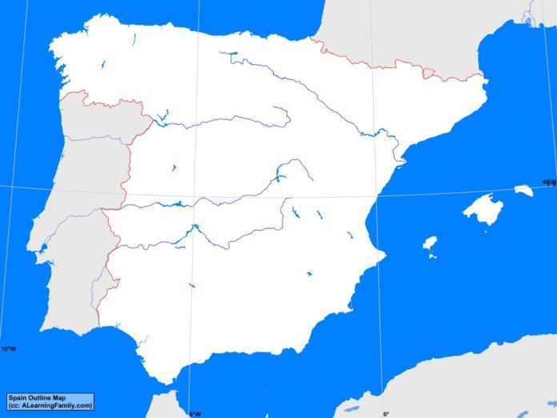
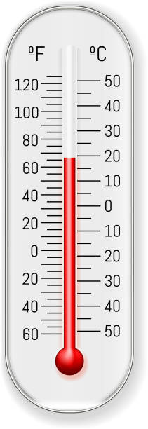
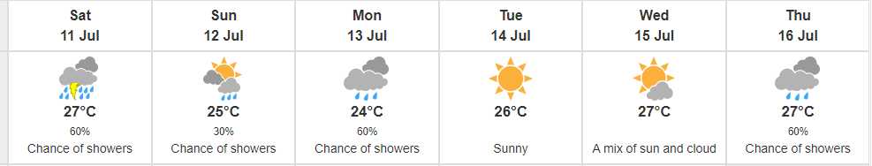
Project Goal
I used four years of hourly electricity demand data for all of Spain paired with hourly weather data for five major cities to perform a long-term (approx. seven months) demand forecast.

Slide 4
Data Wrangling
The datasets contained lots of extra columns that were unnecessary for this analysis, as well as some missing, duplicate, and erroneous data.
Found and deleted duplicate rows
Interpolated some missing values in the energy dataset
Deleted variables (columns) that were not useful for the analysis
Averaged weather data for the five cities
Merged energy and weather datasets

Slide 5
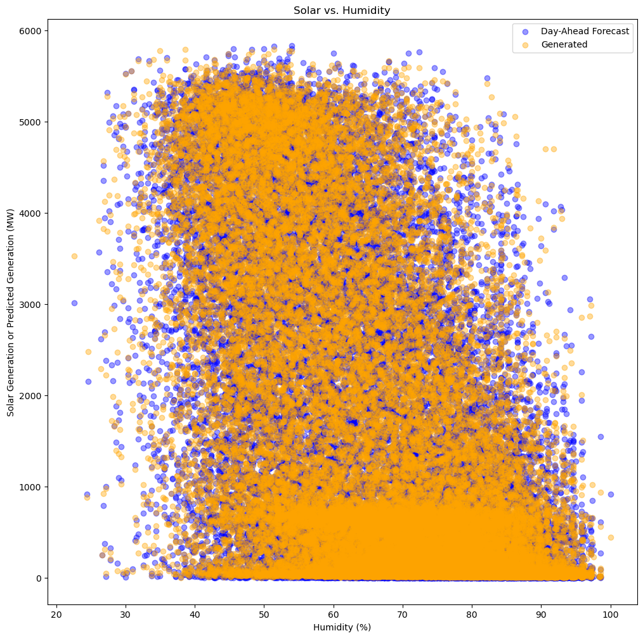
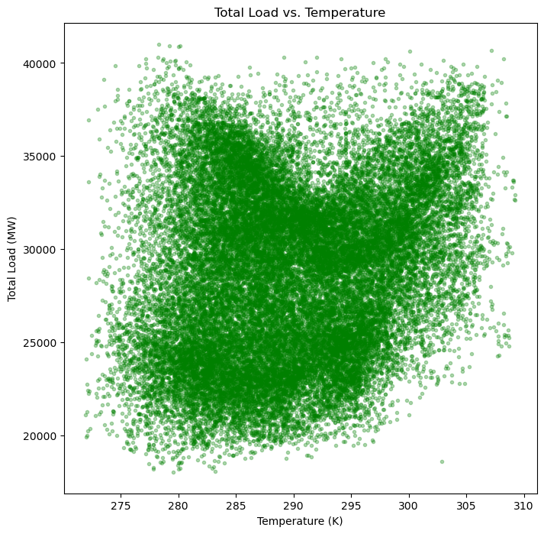
Exploratory Data Analysis
EDA → discovery of:
Erroneously high weather variable values which I imputed with the median.
Relationships between weather variables and both solar generation and total demand

Slide 6
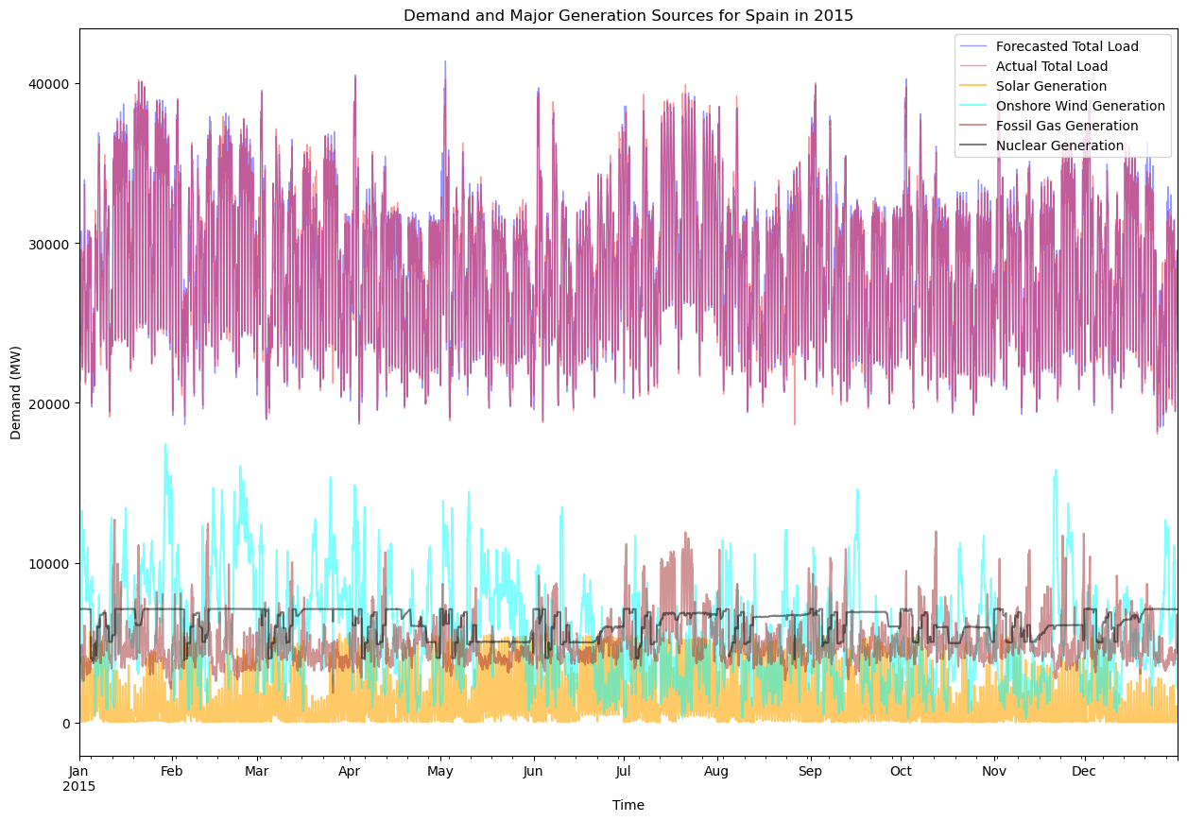
Exploratory Data Analysis
One year of hourly demand and system operator- predicted demand with solar, wind, fossil, and nuclear generation

Slide 7
Feature Engineering
I created some categorical time-based variable for regression models:
Day of the week (M, T, W, Th, F, Sa, Su)
Hour of the day (0-23)
Work/non-work day
Season (Winter, Summer, or Spring/Fall)

Slide 8
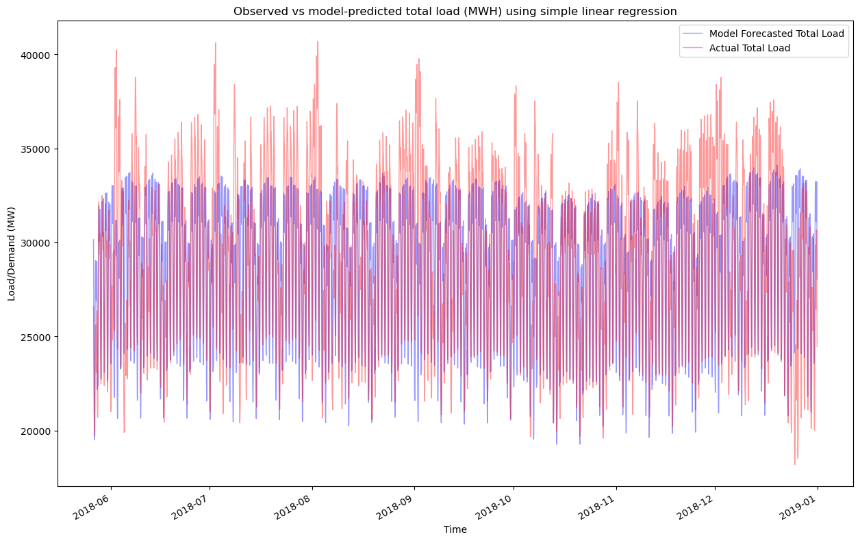
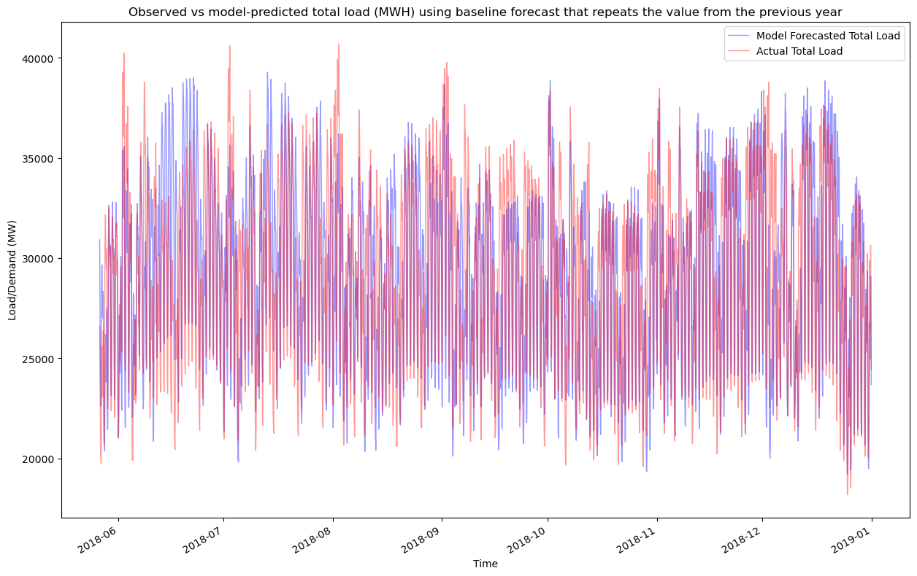
Modeling – Two Baselines
I forecasted using both simple linear regression and a year-over-year to serve as baselines to compare other models to.
RMSE = 2850 MWH
RMSE = 3101 MWH

Slide 9
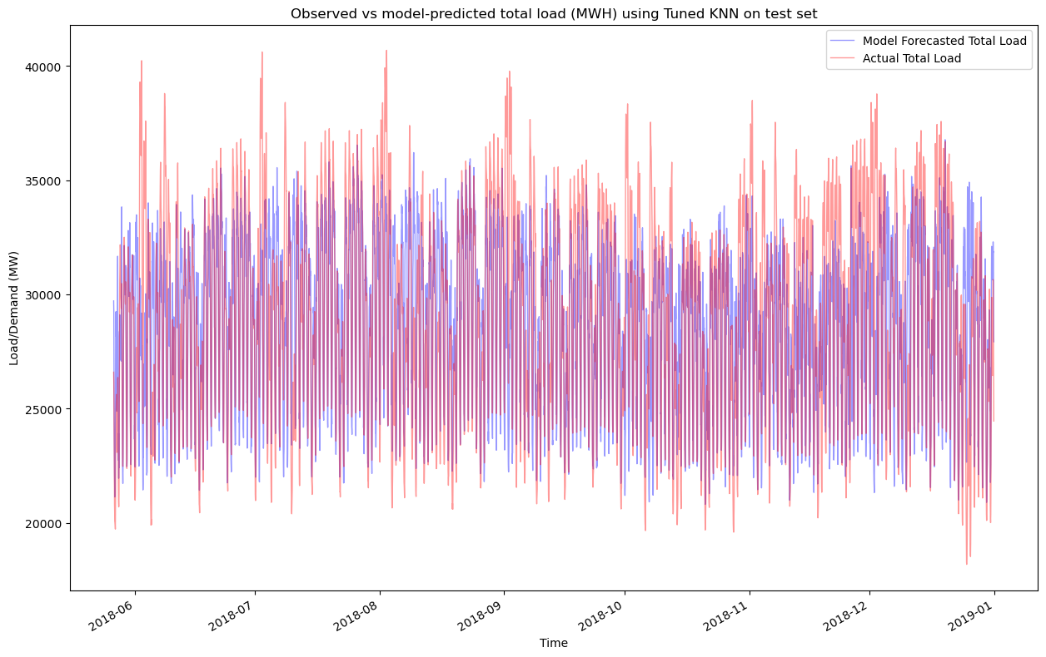
Modeling – Random Forest and KNN
Hyperparameters tuned with 5-fold random search cross validation:
Random Forest
RMSE = 3605 MWH
KNN
RMSE = 3004 MWH

Slide 10
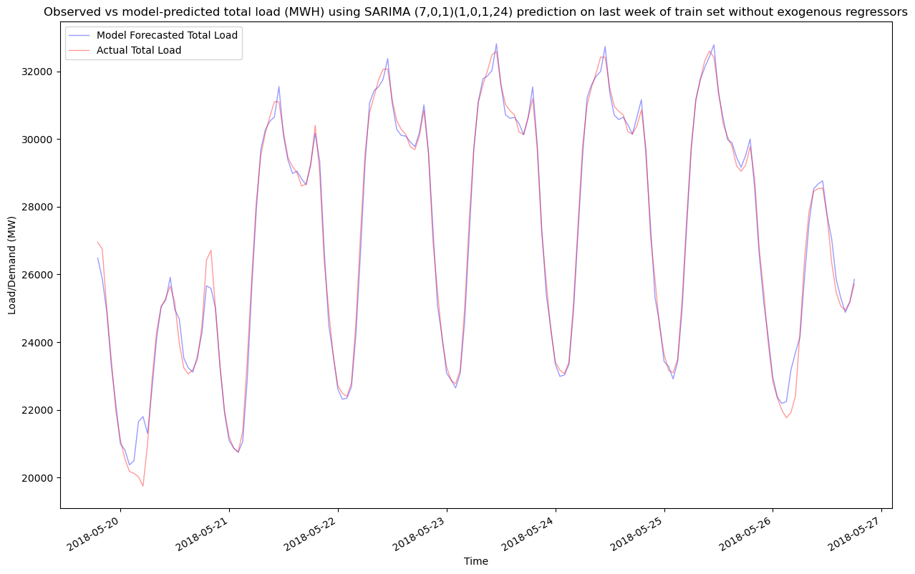
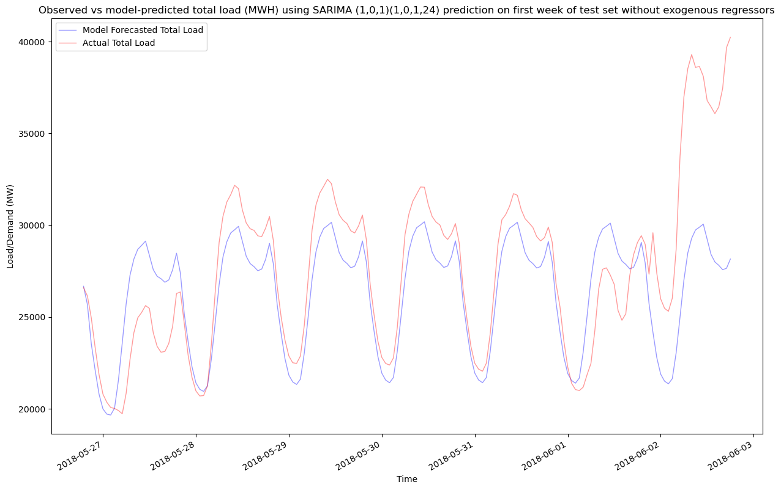
Modeling – Statistical Time Series Forecasting with SARIMAX
Handles a single, short seasonality well but is not suitable for long-tern, multi-seasonality forecasts.

Slide 11
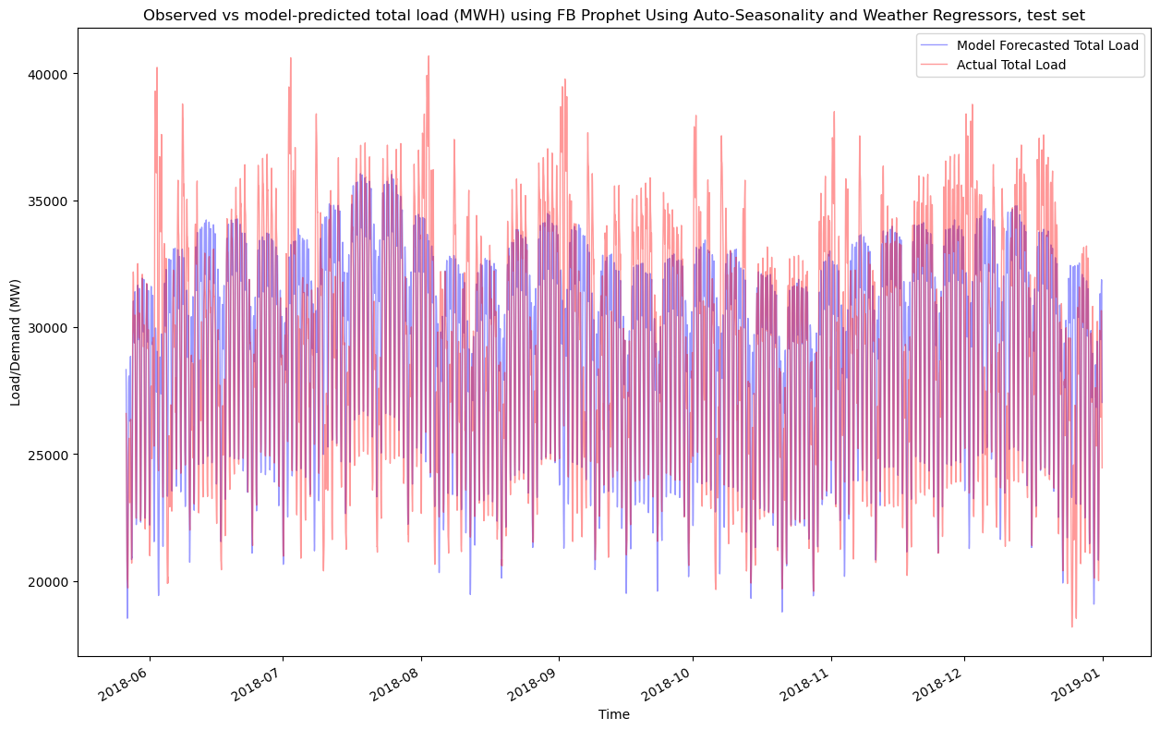
Modeling – Prophet
Time series model developed by Facebook that handles multiple seasonalities and exogenous variables.
RMSE = 2750 MWH

Slide 12
Modeling – XGBoost
Gradient boosted trees-based model; cannot extrapolate, but this data do not have a trend.
Tuned with 5-fold random search cross validation
RMSE = 2820 MWH

Slide 13
Model Selection
Model Name | Test or Train | Forecast Window | RMSE (MWH) | MAE (MWH) | MAPE
Prophet | Train |  | 2666 | 2003 | 7.15
 | Test | 7-month | 2750 | 2069 | 7.23
 | Test | 6 days | 2386 | 1655 | 5.05
XGBoost | Train |  | 2536 | 1871 | 6.69
 | Test | 7-month | 2820 | 2077 | 7.11
SARIMA | Train |  | 366 | 245 | 0.95
 | Test | 6 days | 2006 | 1720 | 6.51
Simple Linear Regression (full feature space) | Train |  | 2861 | 2203 | 764
 | Test | 7-month | 2850 | 2175 | 7.55
KNN | Test | 7-month | 3004 | 2188 | 7.44
Baseline Year-over-Year |  | 7-month | 3101 | 2249 | na

Slide 14
Model Selection
Long-Term Forecasts:
Prophet ≈ XGBoost in terms of prediction error
XGBoost > Prophet in terms of training time; suitable for non-trended data
Prophet > XGBoost for datasets with a trend
Short-Term Forecast:
SARIMA suitable for several hours to a couple days ahead forecasts, but has long training time.

Slide 15
Further Investigation:
Trying different feature sets to feed into XGBoost and Prophet.
Predict contribution of wind-generated energy given wind speed.
Predict energy price given wind generation, solar generation, and total demand.

Slide 16
Thank You
Project on GitHub including Notebooks and Report:
https://github.com/ehardwick2/Capstone2#readme

